Slide 1
FOOD and MEALS

Slide 2
My favourite food
Burgers, pizzas, chicken wings. Tacos, French fries, onion rings. Ice cream, donuts, cookies, cakes. Soda, chips, and chocolate shakes. These are things I like to munch, breakfast, dinner, snack and lunch.

Slide 4
School Meals

Slide 5
Colchester Royal Grammar School Menu

Slide 7
a/some
…bread, …cucumber, …milk, …tomato, …potato, …coffee, …pine apple, …lemon, …carrot,…salt, …roll, ….cherry, …plum, …sugar, …chips.

Slide 8
Choose the correct answer:
1. Would you like … tea?
a. some; b. any.
2. There is … butter in the fridge.
a. some; b. any.
3. We haven’t got … milk.
a. any; b. some.
4. He eats … fish.
a. many; b. much.
5. Why did you eat so … ice creams?
a. many; b. much..
6. There … pine-apples in the basket.
a) is; b. are.

Slide 9
At the Canteen

Slide 10
What do children like to eat*?

Slide 11
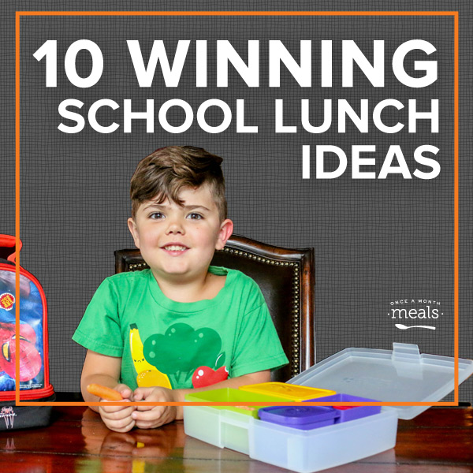

Slide 13
Project “ Today … November 2015 Menu for today

Slide 14
Homework:
Write a letter to Colchester Royal Grammar School and tell them about your school meals.
Sb. Ex.5 p.61

