Slide 1
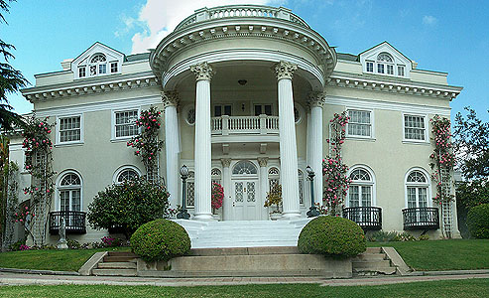
My House

Slide 5
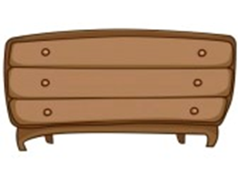
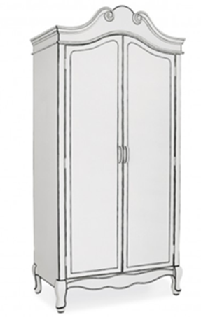
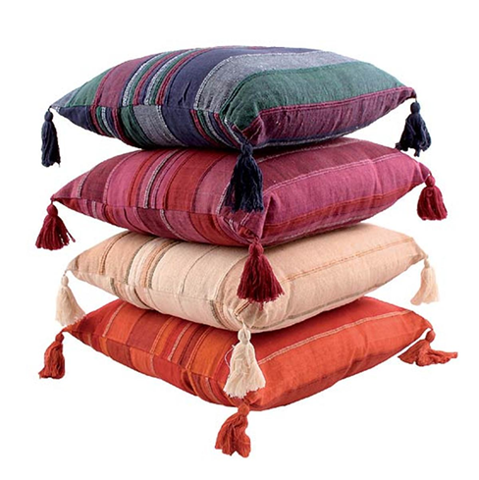

Slide 6
Th []
The , this , there , with.
This is my house
This is my house
This is the door
This is the door
The windows are clean
The windows are clean
And so is the door
So is the door.

Slide 8
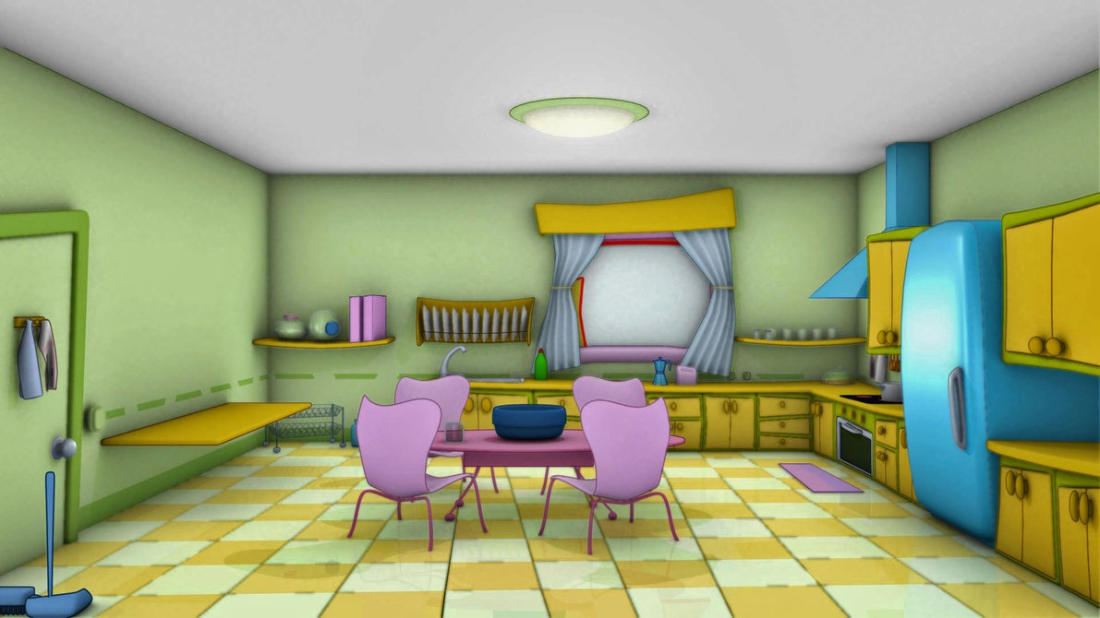
Kitchen

Slide 9
Kitchen
a)
b)
c)
d)
e)
f)

Slide 10
Kitchen
a) √
b) $×$
c) √
d) √
e)$×$
f)$×$

Slide 12
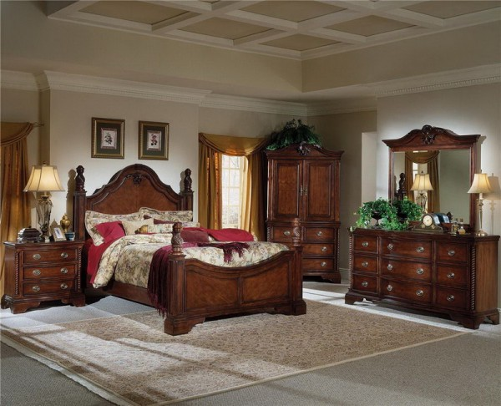
Bedroom

Slide 13
There is a double bed between/behind the windows.
There are some pillows and cushions under/on the bed.
There is a lamp on/next to the bedside cabinet. There is a rug under/next to the bed.
There is a dressing table near/betweenthe wardrobe.
There is a clock and a plant between/in front of the mirror.
There is a plant in/on the dressing table.

Slide 14
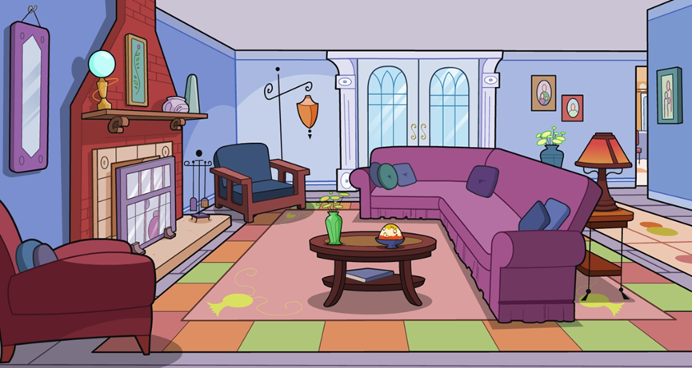
Living room

Slide 15
Living room
Is there a…….
Are there any ….
on
under
next to the ………….. ?
behind
in front of

Slide 17
Video

Slide 18
True or False
1)Anna lives in a flat. False
2) There is a living-room, a kitchen, a study and a hall downstairs. True
3)There is one bedroom and a bathroom upstairs. False
4) Anna’s room is very big. False
5) There is a piano in Anna’s room. False
6) There is a desk in Anna’s room. True

Slide 19
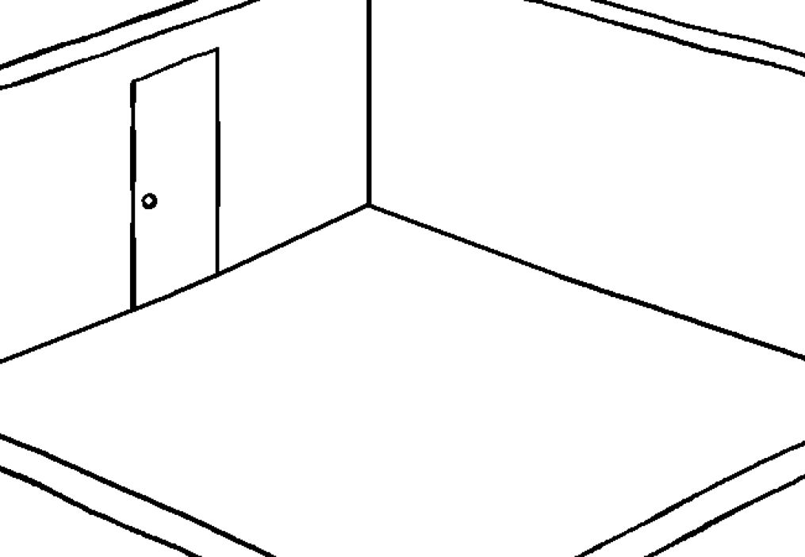
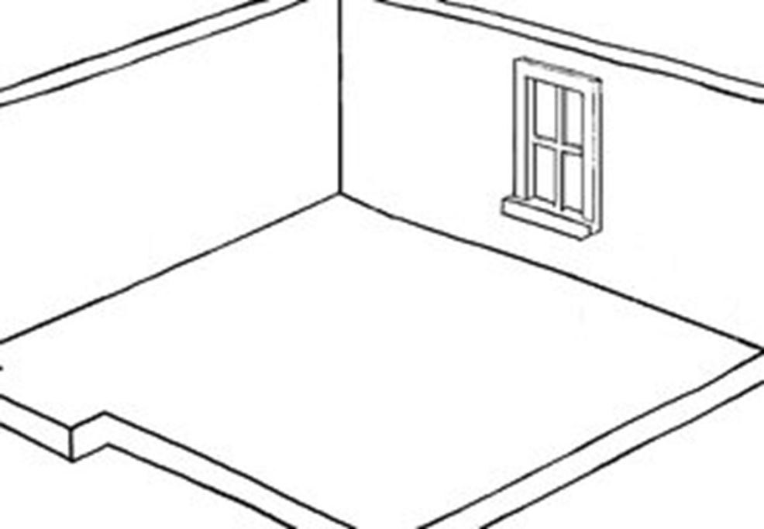
Children’s bedrooms

Slide 20
A letter for Ann

Slide 21
Home task:
a) Take a photo of your room, bring it to the class (electronic variant) and describe your room.
b) Draw an ideal room, bring it to the class and describe your room.
Use the prompts:
This is my room.It is ……….. and …….. .. There is a ………. on (in, under, behind, in front of, next to) the ………….. . There are also some ……………… on (in, under, behind, in front of, next to) the ………….. . I have got a ……… and some …………. . And there is a …………. . There is/are ……… .
I like my new room very much. Home is where the heart is!

